Slide 1
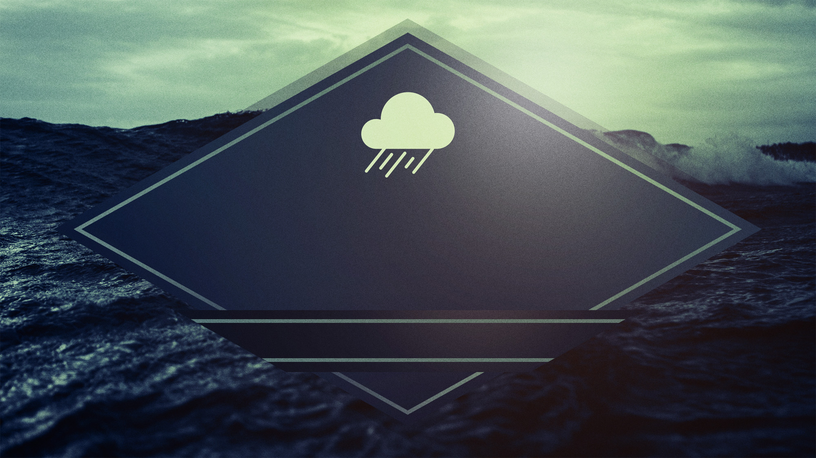
Surviving
Storms
the
Acts 27:13-44

Slide 2
Storms are Usually Unexpected
1. Don’t be Surprised by Storms 2. Don’t be Unprepared for Storms
Surviving
the
Storms

Slide 3
Storms are Difficult
1. Life is Hard 2. Life is Harder with Sin
Surviving
the
Storms

Slide 4
Storms are Terrifying
1. We Do all we can 2. We Lose Control
- Driven by Doubt - Driven by False Doctrinee - Driven by False Teachers
Surviving
the
Storms

Slide 5
3. We Give up Human Answers - We Abandon Control - We Abandon Resources - We Abandon Necessities
Surviving
the
Storms

Slide 6
4. We Give up Hope
Surviving
the
Storms

Slide 7
Lessons
Storm
from
the

Slide 8
We need Each Other
- Paul had Luke - Paul had Aristarchus
- Paul had the Church
- Paul had Julius
Surviving
the
Storms

Slide 9
We need to Pray
“Lord Save me”
“Lord Help me”
“Lord have mercy on me a sinner”
“Lord I believe, help my unbelief”
“Jesus”
Surviving
the
Storms

Slide 10
We need God’s Presence
- In the Holy Spirit - In the Word of God
- In the Church
Surviving
the
Storms

Slide 11
We need to know Who we Are
1. We are His Precious Possession (I Pet 2:9)
2. We are His Workmanship (Eph 2:10)
3. We are His Child (I Jn 3:1)
4. We are His Bride (Eph 5:22-25)
5. We are His Joy (Heb 12:2)
Surviving
the
Storms

Slide 12
We need to Praise God
1. Praise Focuses us on God
2. Praise Draws us closer to God
Surviving
the
Storms

Slide 13
We need to know God’s Promises
God promises all things work for good for His children
God promises comfort in our trials
God promises to finish the work He started in us God promises peace when we pray
God promises to supply all our needs
Surviving
the
Storms

Slide 14
We need God’s Power
- We need to Take Heart - We need to Have Faith
- We need to Buckle Up!
Surviving
the
Storms

Slide 15
We need to know God’s Plan
Surviving
the
Storms

Slide 16
We need to know God Provides
- God wants us to be Practical - God wants us to be Thankful - God wants us to be Encouraged
Surviving
the
Storms

Slide 17
We need to know God Protects
- God Sometimes Delivers in this Life - God Always Delvers in the Next Life
Surviving
the
Storms

